Slide 1

MACHINE LEARNING WORKSHOP
Developer Community SASTRA
Computers are able to see, hear and learn. Welcome to the future.

Slide 2
/AGENDA
/01
/INTRODUCTION
/02
/DATA PROCESSING
/03
/ALGORITHMS
/04
/SHAP AND ETHICS
Developer Community SASTRA
What is ML?
Applications
Types of Data
Data analysis & processing
EDA
Data cleaning
Feature Engineering
Data preparation
Classification
Clustering
Regression
SHAP - model interpretation
Data concerns
Notes:
So this is the agenda of our Workshop.
……………..need to write
Data cleaning - null values and all

Slide 3
/01
/WHAT IS ML?
Developer Community SASTRA
Notes:
What is ML?
In general , Machine learning is an application of AI that enables systems to learn and improve from experience without being explicitly programmed. Machine learning focuses on developing computer programs that can access data and use it to learn for themselves.
At a very high level, machine learning is the process of teaching a computer system how to make accurate predictions when fed data.

Slide 4
/AI , ML , DL
/AI
/ML
/DL
Developer Community SASTRA
AI is ability of machines to function like human brain.
ML is a subset of AI that use statistical methods to learn and improve from data
DL is class of ML algorithms inspired by the structure of human brain.
Notes:
Artificial Intelligence, Machine Learning, Deep Learning, Data Science are popular terms in this era. And knowing what it is and the difference between them is more crucial than ever. Although these terms might be closely related there are differences between them as shown.
AI
AI is defined as engineering of making intelligent machines and programs
This can be anything from programmed software to deep learning models which mimics human brain
ML
Machine learning is specific kind of Artificial intelligence , which learns how to do something from examples rather than explicitly told what to do.DL
DL
It is a sub branch of Machine learning using a technique known as neural network, which connects multiple models together to solve complex problems
It is basically connecting many ml models to other models in layers to handle more complex data like images and text.

Slide 5
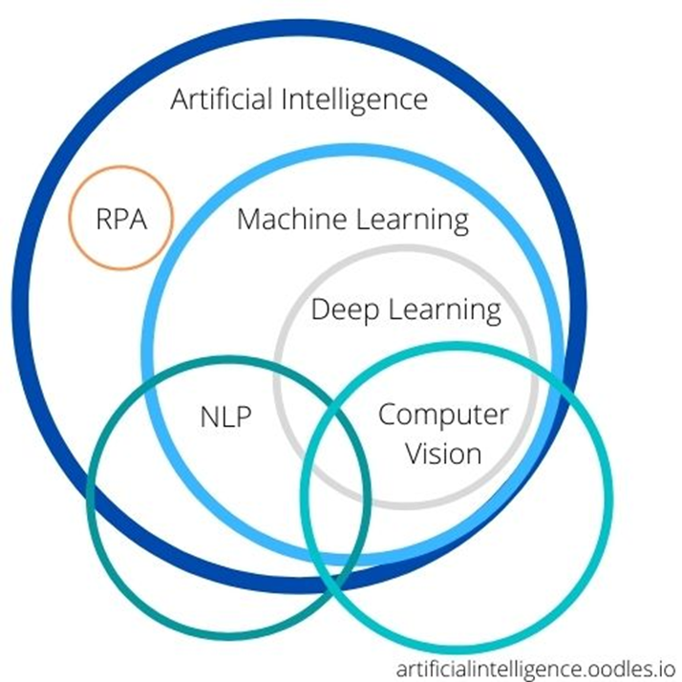
/AI vs ML vs DL
Developer Community SASTRA
Notes:
Here we can see the difference between AI , ML and DL through venn diagram. We can see that AI is the technology and ML is the subset of it. And DL is the improvised algorithm of ML.

Slide 6
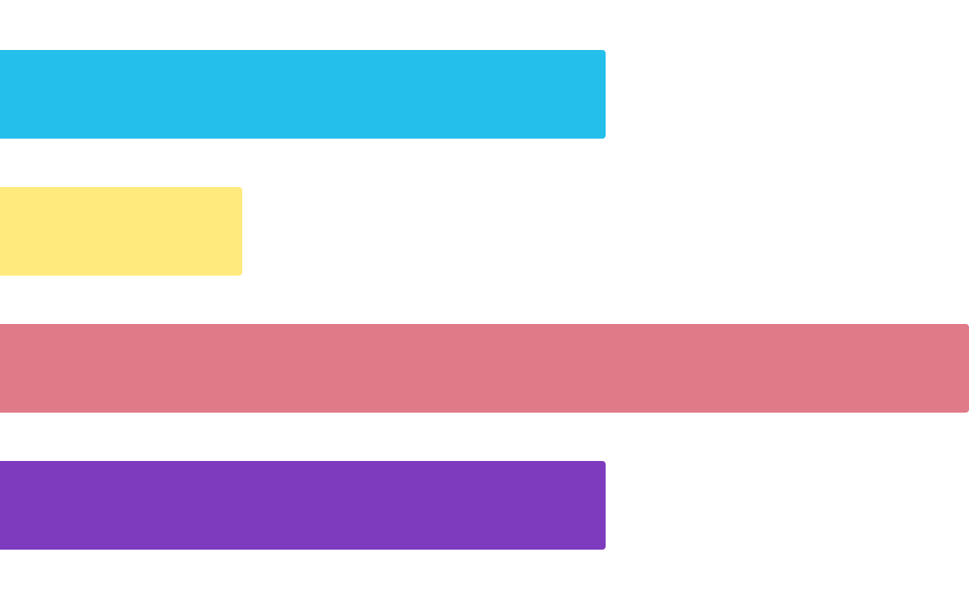
/APPLICATIONS OF AI
Developer Community SASTRA
0
25
50
75
100
/Stock Price Prediction
/Sale Optimisation
/Recommendations System
/Personal Assistant
Notes:
In the past decade, machine learning has given us self-driving cars, practical speech recognition, effective web search, and a vastly improved understanding of the human genome. Machine learning is so pervasive today that you probably use it dozens of times a day without knowing it.
Machine learning applications and use cases are nearly endless, especially as we begin to work from home more (or have hybrid offices), become more tied to our smartphones, and use machine learning-guided technology to get around.
Machine learning in finance(somesone who used ml to increase ), healthcare, hospitality, government, and beyond, is already in regular use. Businesses are beginning to see the benefits of using machine learning tools to improve their processes, gain valuable insights from unstructured data, and automate tasks that would otherwise require hours of tedious, manual work (which usually produces much less accurate results).
For example, UberEats uses machine learning to estimate optimum times for drivers to pick up food orders, while Spotify leverages machine learning to offer personalized content and personalized marketing. And Dell uses machine learning text analysis to save hundreds of hours analyzing thousands of employee surveys to listen to the voice of employee (VoE) and improve employee satisfaction.
How do you think Google Maps predicts peaks in traffic and Netflix creates personalized movie recommendations, even informs the creation of new content ? By using machine learning, of course.

Slide 7
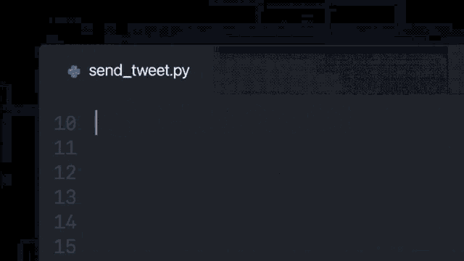
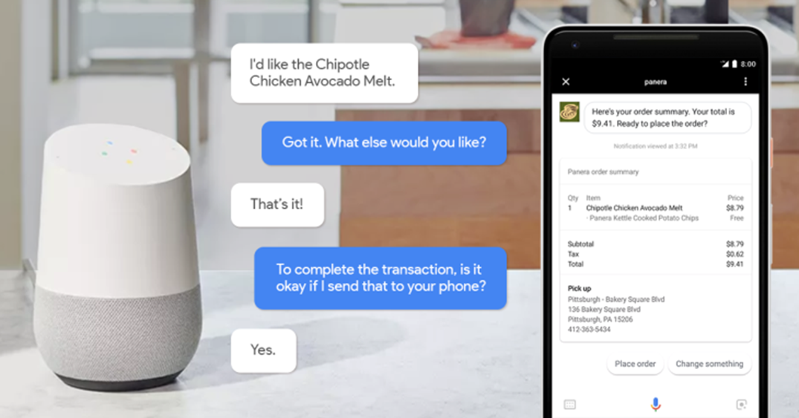
/APPLICATIONS OF AI
Developer Community SASTRA
Notes:
Images of ubereats app , spotify wrap/rec.
In the meantime, here are some common machine learning use cases and applications that might spark some ideas:
Social Media Monitoring
Customer Service & Customer Satisfaction
Image Recognition
Virtual Assistants
Product Recommendations
Stock Market Trading
Medical Diagnosis

Slide 8
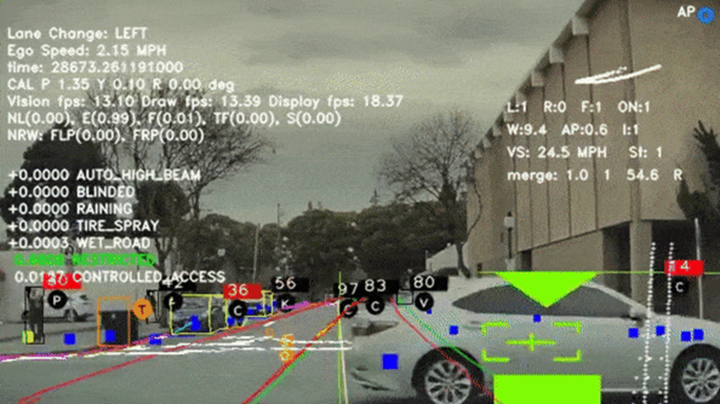
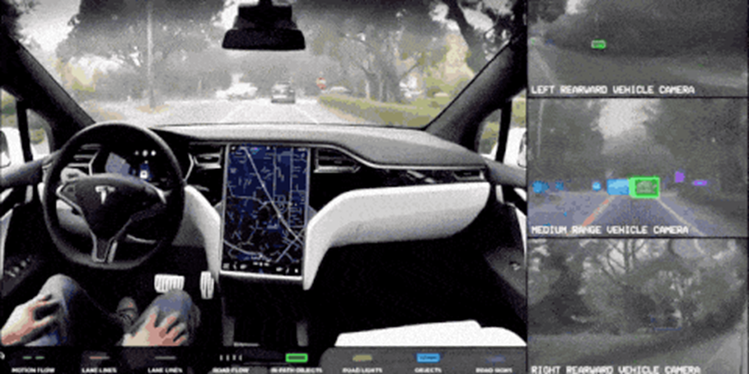
Developer Community SASTRA
/TESLA AUTOPILOT

Slide 9
/MACHINE LEARNING PROCESS
/GET DATA
/TRAIN MODEL
/DATA PREPROCESSING
/PREDICT OUTPUT
Developer Community SASTRA
Data from reliable resources
Choosing right algorithm
Major task
Improve model
Notes:
While machine learning offers powerful new opportunities, implementing a machine learning system can be more complex than traditional software. This is primarily because machine learning model is only as good as the data it is trained on. In this section i will provide an overview of the process as well as important considerations.

Slide 10
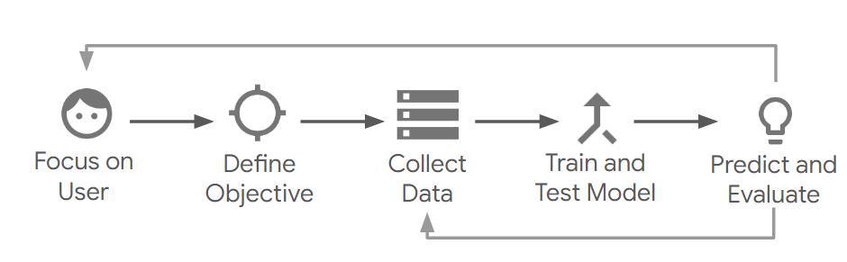
< MACHINE LEARNING LIFE CYCLE >
Developer Community SASTRA
Notes:
1. Machine learning begins with the needs of your user and business.
2. With this in mind, you define an objective so you know how to proceed.
exmaples could include:
i. Predict which friends a usr is likely to share a photo with.
Ii. Suggest the user should eat in a new city based on the restaurants they have visited in the past.
These goals should articulate success metrics as well.
3. Machine learning models learn from examples so it is essential to find a large existing source of data that is relevant to your problem.
Experts say collecting , cleaning ,exploring and other data processes tend to be the longest but most critical part of the process.
4. The arrow pointing back from prediction to data shows iterative nature of ML. you will need to refine your model and perhaps your data collection and processsing based on the feedback until it is achieving the results you are looking for.

Slide 11
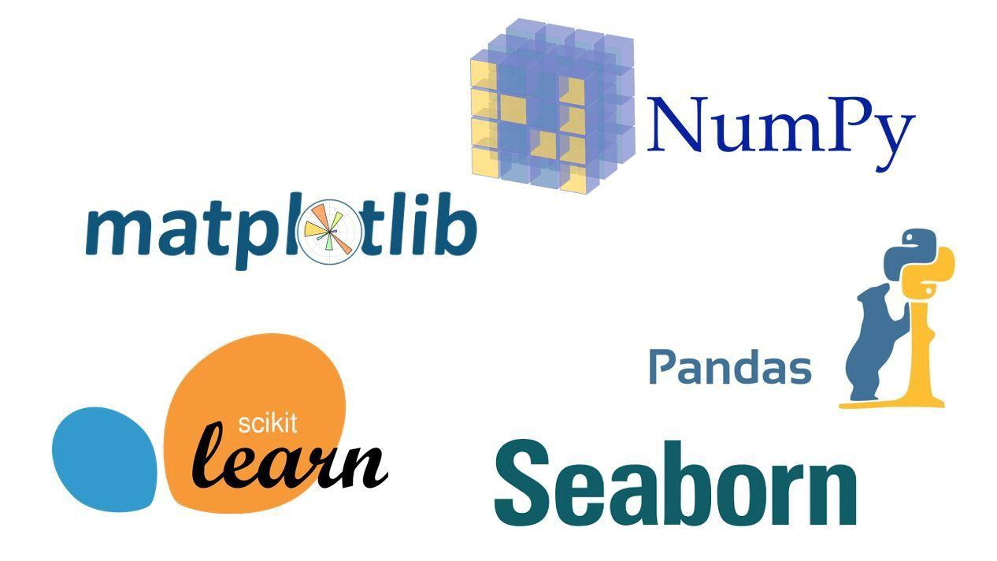
/GETTING STARTED WITH LIBRARIES
Developer Community SASTRA
Notes:
As we start learning ML in python, choosing correct libraries plays a major role.
The first obstacle you encounter when working with big data is the realization that numerical calculations with multidimensional arrays are slow and inefficient. Here numpy is used.
The advantage of Numpy lies in its simplicity. The library is defining N-dimensional array objects as the main data structure. Basic operations on this data structure are then provided: indexing, reshaping, sorting & others.
Then comes sciPy which is the extension of numpy to perform more advanced statistical analysis.
To deal with unstructured and misaligned data we use panda library. makes it easy to manipulate and analyze complex, multidimensional datasets.
Matplotlib is a data visualization library that is used for 2D plotting to produce publication-quality image plots and figures in a variety of formats. The library helps to generate histograms, plots, error charts, scatter plots, bar charts with just a few lines of code.
Scikit-learn has a wide range of supervised and unsupervised learning algorithms that works on a consistent interface in Python. The library can also be used for data-mining and data analysis.
Seaborn is an amazing visualization library for statistical graphics plotting in Python. It provides beautiful default styles and color palettes to make statistical plots more attractive. It is built on the top of matplotlib library and also closely integrated to the data structures from pandas.

Slide 12
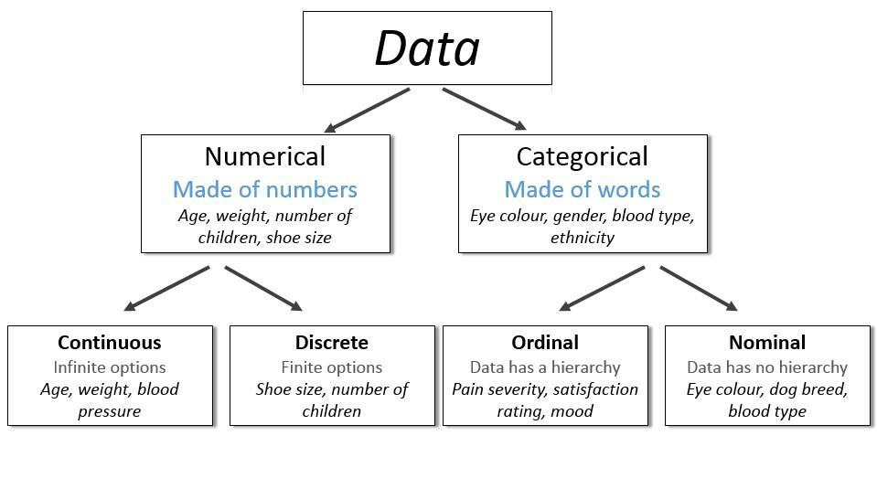
/TYPES OF DATA
Developer Community SASTRA
Notes:
Data is of many forms such text , images , audio , tabular etc. here we are only going to discuss about tabular data which contains numeric and categorical data.
Numeric data will be continuous. And categorical data will have discrete classes of data.

Slide 13
/DATA CLEANING
/REMOVAL OF UNWANTED OBSERVATIONS
/HANDLING MISSING DATA
/MANAGING UNWANTED OUTLINERS
/FIXING STRUCTURAL ERRORS
Developer Community SASTRA

Slide 14

/TAKING CARE OF MISSING DATA
Developer Community SASTRA
Deletion of data
Imputation of data
Notes:
The real-world data often has a lot of missing values. The cause of missing values can be data corruption or failure to record data. The handling of missing data is very important during the preprocessing of the dataset as many machine learning algorithms do not support missing values.
It is important to handle the missing values appropriately.
Many machine learning algorithms fail if the dataset contains missing values. However, algorithms like K-nearest and Naive Bayes support data with missing values.
You may end up building a biased machine learning model which will lead to incorrect results if the missing values are not handled properly.
Missing data can lead to a lack of precision in the statistical analysis.
These are handled in broadly two ways such as deletion of data and imputation of data
Deletion of data include
just ignore the observation by deleting it
Imputation of data include
KNN based methods are used
Replacing with mean, mean or mode values
And for time series forward fill and backward fill is used.

Slide 15
/ENCODING CATEGORICAL DATA
Developer Community SASTRA
Process of converting categorical data into integer format so that the data with converted categorical values can be provided to models to give and improve the predictions.
One-Hot encoding
Dummy encoding
Notes:
Encoding categorical data is a process of converting categorical data into integer format so that the data with converted categorical values can be provided to the models to give and improve the predictions.
Ordinal encoding follows hierarchy while label encoding doesnt.
In One-Hot Encoding, each category of any categorical variable gets a new variable. It maps each category with binary numbers (0 or 1). This type of encoding is used when the data is nominal. Newly created binary features can be considered dummy variables. After one hot encoding, the number of dummy variables depends on the number of categories presented in the data.
Dummy coding scheme is similar to one-hot encoding. This categorical data encoding method transforms the categorical variable into a set of binary variables (also known as dummy variables). In the case of one-hot encoding, for N categories in a variable, it uses N binary variables. The dummy encoding is a small improvement over one-hot-encoding. Dummy encoding uses N-1 features to represent N labels/categories.

Slide 16
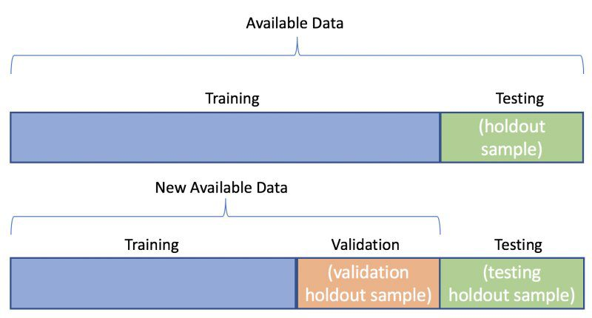
/SPLITTING OF DATA
Developer Community SASTRA
/Training
/Validation
/Testing

Slide 17

/FEATURE SCALING
Developer Community SASTRA
Notes:
Why do we need to use feature scaling ?
What is Normalization?
Normalization is a scaling technique in which values are shifted and rescaled so that they end up ranging between 0 and 1. It is also known as Min-Max scaling.
Standardization is another scaling technique where the values are centered around the mean with a unit standard deviation. This means that the mean of the attribute becomes zero and the resultant distribution has a unit standard deviation.

Slide 18
/02
/ALGORITHMS
Developer Community SASTRA

Slide 19
<Classification>
Developer Community SASTRA
Classification is the process of recognizing, understanding, and grouping ideas and objects into preset categories or “sub-populations.” Using pre-categorized training datasets, machine learning programs use a variety of algorithms to classify future datasets into categories.

Slide 20
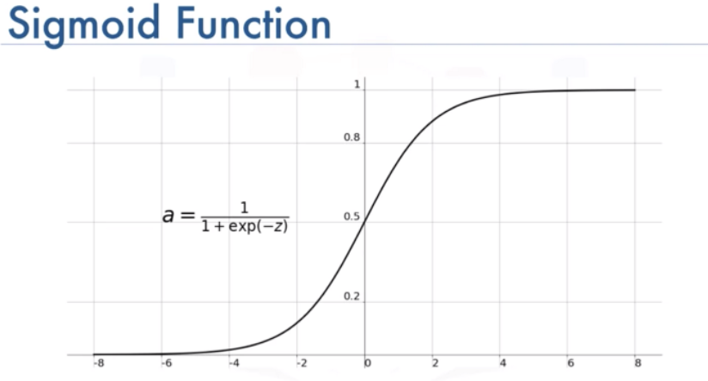
/What is Logistic Regression
Developer Community SASTRA
1.Logistic regression is a calculation used to predict a binary outcome: either something happens, or does not. This can be exhibited as Yes/No, Pass/Fail, Alive/Dead, etc.
2.P(Y=1|X) or P(Y=0|X)
3.It calculates the probability of dependent variable Y, given independent variable X.
4. This can be used to calculate the probability of a word having a positive or negative connotation (0, 1, or on a scale between). Or it can be used to determine the object contained in a photo (tree, flower, grass, etc.), with each object given a probability between 0 and 1.
5.

Slide 21
Developer Community SASTRA
/Logistic Regression

Slide 22
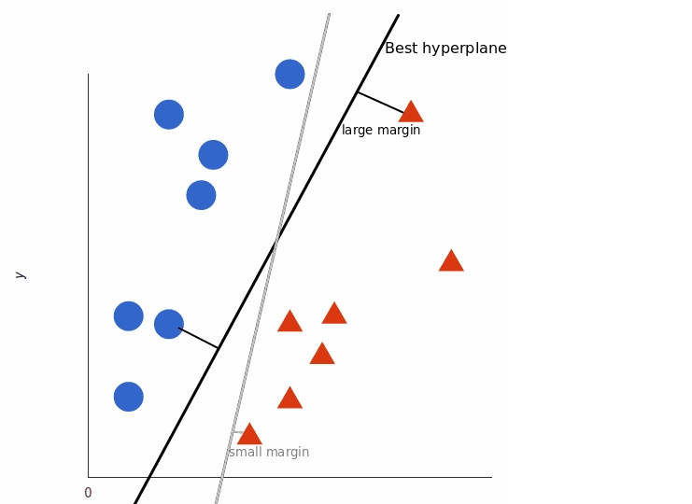
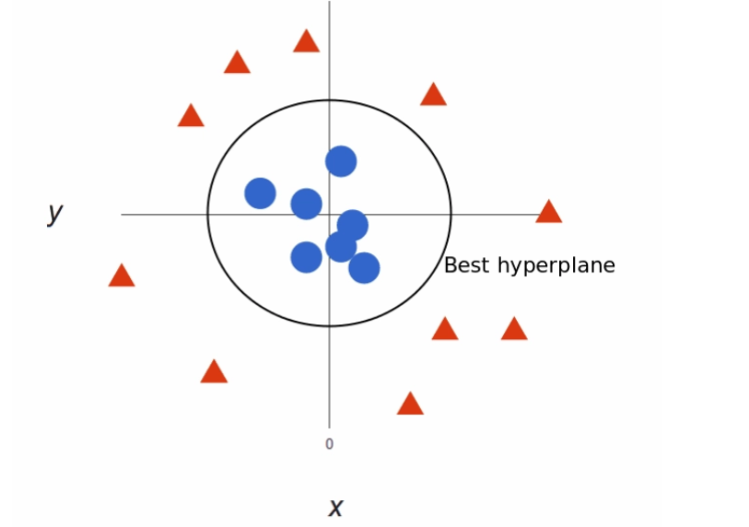
/What is SVM
Developer Community SASTRA
1.The objective of SVM algorithm is to find a hyperplane in an N-dimensional(n being the number of features) space that distinctly classifies the data points.
2.Linear and Non linear
3.Large Margin classifier

Slide 23
/What is Decision Tree
Developer Community SASTRA
The decision tree Algorithm belongs to the family of supervised machine learning algorithms. It can be used for both a classification problem as well as for regression problem.
The goal of this algorithm is to create a model that predicts the value of a target variable, for which the decision tree uses the tree representation to solve the problem in which the leaf node corresponds to a class label and attributes are represented on the internal node of the tree.

Slide 24
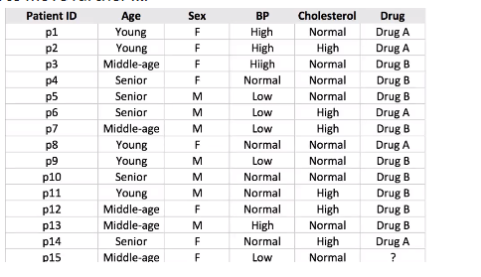
/Decision Tree
Developer Community SASTRA

Slide 25
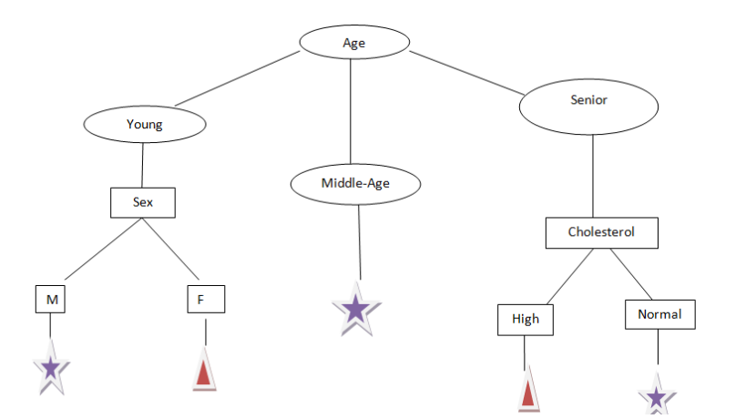
/Illustration of Decision Tree

Slide 26
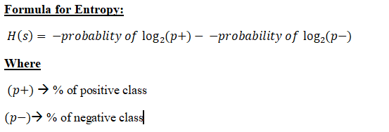
/Decision Tree
Developer Community SASTRA
Entropy: Entropy is the measures of impurity, disorder, or uncertainty in a bunch of examples.
Entropy controls how a Decision Tree decides to split the data. It affects how a Decision Tree draws its boundaries.

Slide 27
/Random forest Classifier
Developer Community SASTRA
What is a random forest
1.A random forest consists of multiple random decision trees. Two types of randomness are built into the trees. First, each tree is built on a random sample from the original data. Second, at each tree node, a subset of features are randomly selected to generate the best split.
2.The algorithm generates proximity matrix. This matrix gives a rough estimate of distance between samples based on the proportion of times the samples end up in same leaf node. The proximity matrix is converted to a dist matrix
3I.IF two cases occupy the same terminal node through one tree, their proximity is increased by one

Slide 28
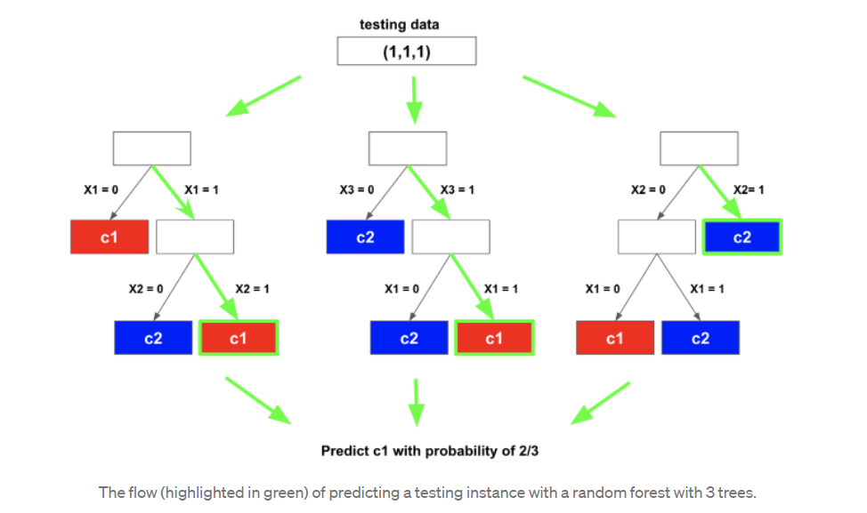
/Random forest Classifier
Developer Community SASTRA

Slide 29
/XG BOOST CLASSIFIER
Developer Community SASTRA
Unlike many other algorithms, XG Boost is an ensemble learning algorithm meaning that it combines the results of many models, called base learners to make a prediction.
Trees used by XGBoost are a bit different than traditional decision trees. They are called CART trees (Classification and Regression trees) and instead of containing a single decision in each “leaf” node, they contain real-value scores of whether an instance belongs to a group. After the tree reaches max depth, the decision can be made by converting the scores into categories using a certain threshold.
It is an ensemble of decision trees algorithm where new trees fix errors of those trees that are already part of the model. Trees are added until no further improvements can be made to the model.

Slide 30
/K Nearest Neighbours
Developer Community SASTRA
K-nearest neighbors (k-NN) is a pattern recognition algorithm that uses training datasets to find the k closest relatives in future examples.
When k-NN is used in classification, you calculate to place data within the category of its nearest neighbor.
Birds of a feather flock together
The closest class to the point which is to be classified is calculated using Euclidean distance.
KNN works on a principle assuming every data point falling in near to each other is falling in the same class. In other words, it classifies a new data point based on similarity.

Slide 31
/K Nearest Neighbours
Developer Community SASTRA
The KNN Algorithm
1.Load the data
2.Initialize K to your chosen number of neighbors
3. For each example in the data
3.1 Calculate the distance between the query example and the current example from the data.
3.2 Add the distance and the index of the example to an ordered collection
4. Sort the ordered collection of distances and indices from smallest to largest (in ascending order) by the distances
5. Pick the first K entries from the sorted collection
6. Get the labels of the selected K entries
7. If regression, return the mean of the K labels
8. If classification, return the mode of the K labels

Slide 32
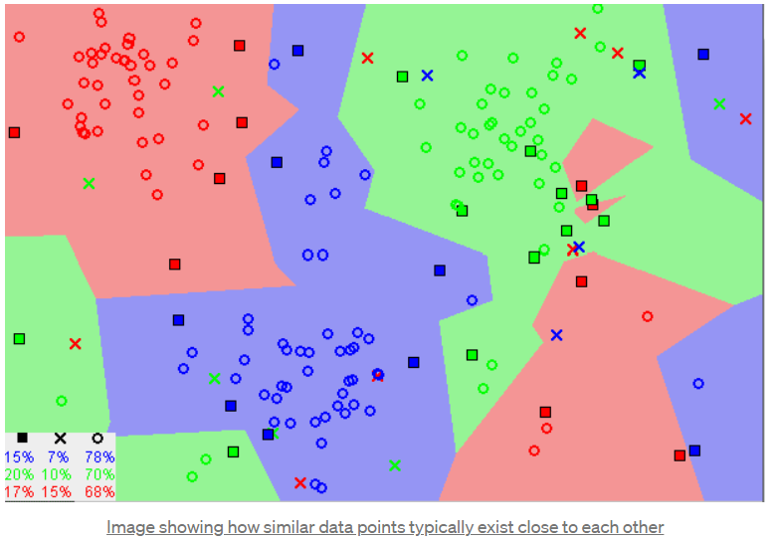
/K Nearest Neighbours

Slide 33
<Clustering>
Developer Community SASTRA
A way of grouping the data points into different clusters, consisting of similar data points. The objects with the possible similarities remain in a group that has less or no similarities with another group..

Slide 34
/ K Means
Developer Community SASTRA
1.K-means clustering is one of the simplest and popular unsupervised machine learning algorithms.
2.You’ll define a target number k, which refers to the number of centroids you need in the dataset. A centroid is the imaginary or real location representing the center of the cluster.
3.Every data point is allocated to each of the clusters through reducing the in-cluster sum of squares.
4.In other words, the K-means algorithm identifies k number of centroids, and then allocates every data point to the nearest cluster, while keeping the centroids as small as possible
5.The ‘means’ in the K-means refers to averaging of the data; that is, finding the centroid.

Slide 35
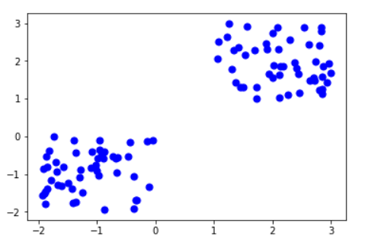
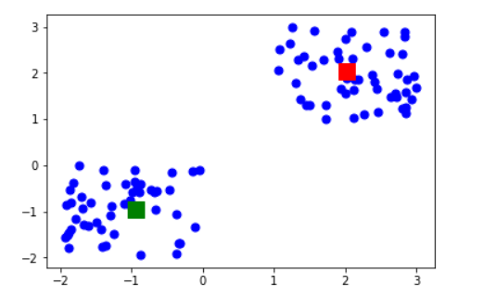
/K Means
Developer Community SASTRA

Slide 36
<Regression>
Developer Community SASTRA
Regression is a method for understanding the relationship between independent variables or features and a dependent variable or outcome. Outcomes can then be predicted once the relationship between independent and dependent variables has been estimated.

Slide 37
/Linear regression
Developer Community SASTRA
1.Linear regression is one of the easiest and most popular Machine Learning algorithms. It is a statistical method that is used for predictive analysis. Linear regression makes predictions for continuous/real or numeric variables such as sales, salary, age, product price, etc.
2.Linear regression algorithm shows a linear relationship between a dependent (y) and one or more independent (y) variables, hence called as linear regression.
3.Since linear regression shows the linear relationship, which means it finds how the value of the dependent variable is changing according to the value of the independent variable.
4.The linear regression model provides a sloped straight line representing the relationship between the variables.

Slide 38
/Linear regression
Developer Community SASTRA
y= a0+a1x+ ε
Y= Dependent Variable (Target Variable)
X= Independent Variable (predictor Variable)
a0= intercept of the line (Gives an additional degree of freedom)
a1 = Linear regression coefficient (scale factor to each input value).
ε = random error

Slide 39
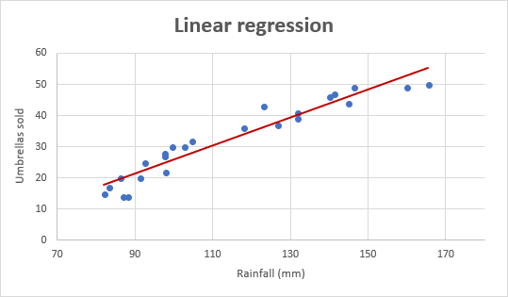
/Linear regression
Developer Community SASTRA

Slide 40
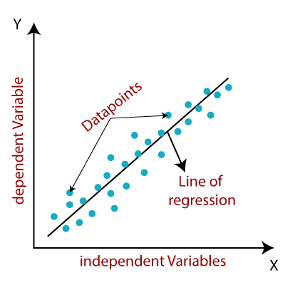
/Linear regression
Developer Community SASTRA

Slide 41
/Decision tree regression
Developer Community SASTRA
1.Decision trees are versatile machine learning algorithm capable of performing both regression and classification task and even work in case of tasks which has multiple outputs.
2.Decision tree uses the tree representation to solve the problem in which each leaf node corresponds to a class label and attributes are represented on the internal node of the tree.
3. The value obtained by leaf nodes in the training data is the mean response of observation falling in that region
4. A regression tree follows a top-down greedy approach.
5. INSTABILITY OF REGRESSION TREES. ITS PRONE TO OVERFITTING.
6. Unlike linear regression models that calculate the coefficients of predictors, tree regression models calculate the relative importance of predictors.

Slide 42
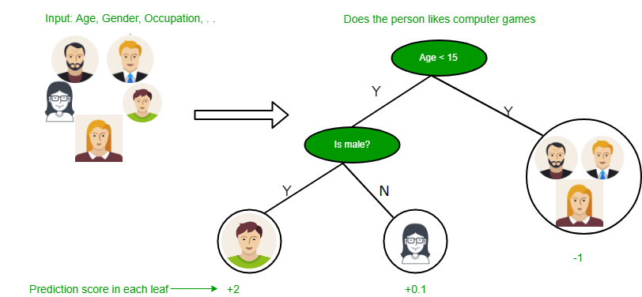
/Decision Tree
Developer Community SASTRA

Slide 43
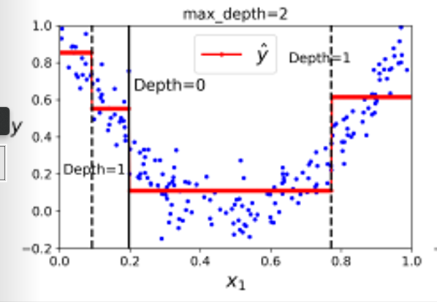
/Decision tree
Developer Community SASTRA

Slide 44
/Random Forest regression
Developer Community SASTRA
1. Random Forest Regression is a supervised learning algorithm that uses ensemble learning method for regression.
2.Ensemble learning method is a technique that combines predictions from multiple machine learning algorithms to make a more accurate prediction than a single model.
ALGORITHM:
1)Pick at random k data points from the training set.
2)Build a decision tree associated to these k data points.
3)Choose the number N of trees you want to build and repeat steps 1 and 2.
4)For a new data point, make each one of your N-tree trees predict the value of y for the data point in question and assign the new data point to the average across all of the predicted y values.

Slide 45
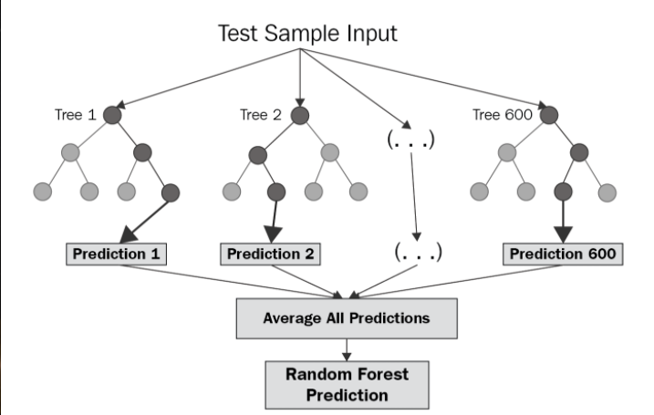
/Random forest regression
Developer Community SASTRA

Slide 46
/Boosting
Developer Community SASTRA
1 . "Boosting" in machine learning is a way of combining multiple simple models into a single composite model. This is also why boosting is known as an additive model, since simple models (also known as weak learners) are added one at a time, while keeping existing trees in the model unchanged. As we combine more and more simple models, the complete final model becomes a stronger predictor. The term "gradient" in "gradient boosting" comes from the fact that the algorithm uses gradient descent to minimize the loss.
2. The general idea of most
boosting methods is to train predictors sequentially, each trying to correct its predecessor.
3.WORKING:
The ensemble consists of N trees. Tree1 is trained using the feature matrix X and the labels y. The predictions labelled y1(hat) are used to determine the training set residual errors r1. Tree2 is then trained using the feature matrix X and the residual errors r1 of Tree1 as labels. The predicted results r1(hat) are then used to determine the residual r2. The process is repeated until all the N trees forming the ensemble are trained.

Slide 47
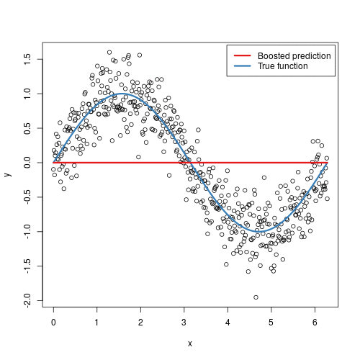
/Boosting
Developer Community SASTRA

Slide 48
/SHAP
Developer Community SASTRA
But why does the model predict that?
How much does each feature contribute to the prediction?
Wouldn’t it be nice if you can see a plot indicating how much each feature contributes to the prediction like below?
The Shapley value is a method used in game theory that involves fairly distributing both gains and costs to actors working in a coalition.
Since each actor contributes differently to the coalition, the Shapley value makes sure that each actor gets a fair share depending on how much they contribute.

Slide 49
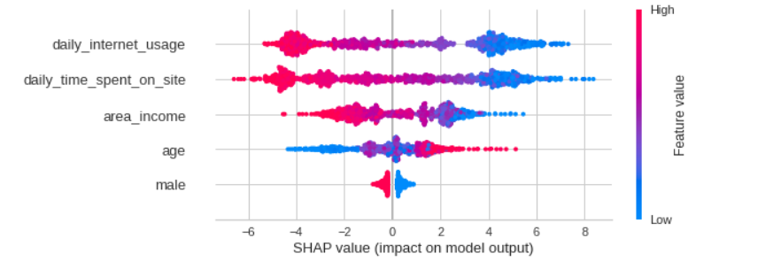
/SHAP
Developer Community SASTRA

Slide 50
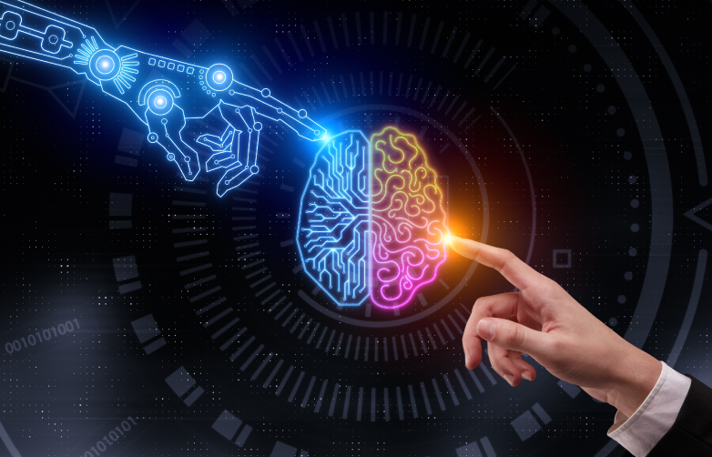
/03
/ETHICS IN ML
Developer Community SASTRA
Challenges ahead and solutions…

Slide 51

/BIAS
Developer Community SASTRA
Amazon uses a ML algorithm for its recruitment process. And in 2015 , they found that the algorithm has a gender bias.
And why do you think so??

Slide 52
Developer Community SASTRA
It’s because of the data the
algorithm was fed. The data had a higher amount of men applying and as the number of resumes is a parameter chosen, we had a skewed result.
So, the data we choose must be unbiased as well as the parameters we consider should be reasonable.

Slide 53

Developer Community SASTRA
/DATA ETHICS
It is a company which helps people to understand their genetic makeup for 100$.
Customers had their data shared with drug insurance corporations, or even academic labs

Slide 54
Developer Community SASTRA
/DATA ETHICS
So ,we have to get consent of people or organization whose data
we are working on, to use the data.
And as well as the way we are
using the data.

Slide 55
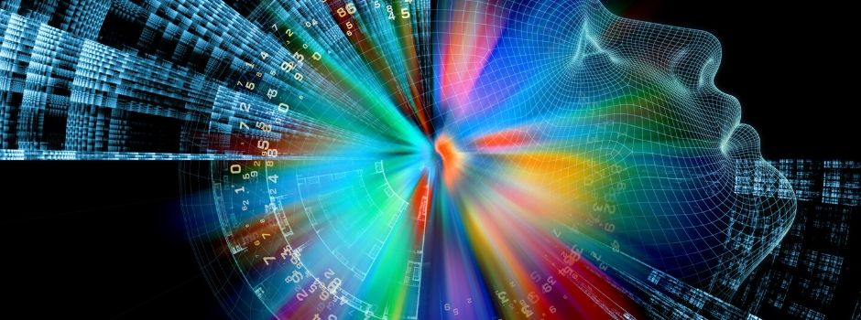
Developer Community SASTRA
/PATENT
In 2016, a Rembrandt painting was created by AI.
346 Rembrandt paintings were analyzed pixel by pixel and up-scaled by deep learning algorithms to create a unique database and algorithm created a masterpiece itself.

Slide 56
Developer Community SASTRA
/PATENT
Now, the real question comes to whom this
drawing belongs to ??
The algorithm? The engineer? The organization? Or the Rembrandt himself??

Slide 57
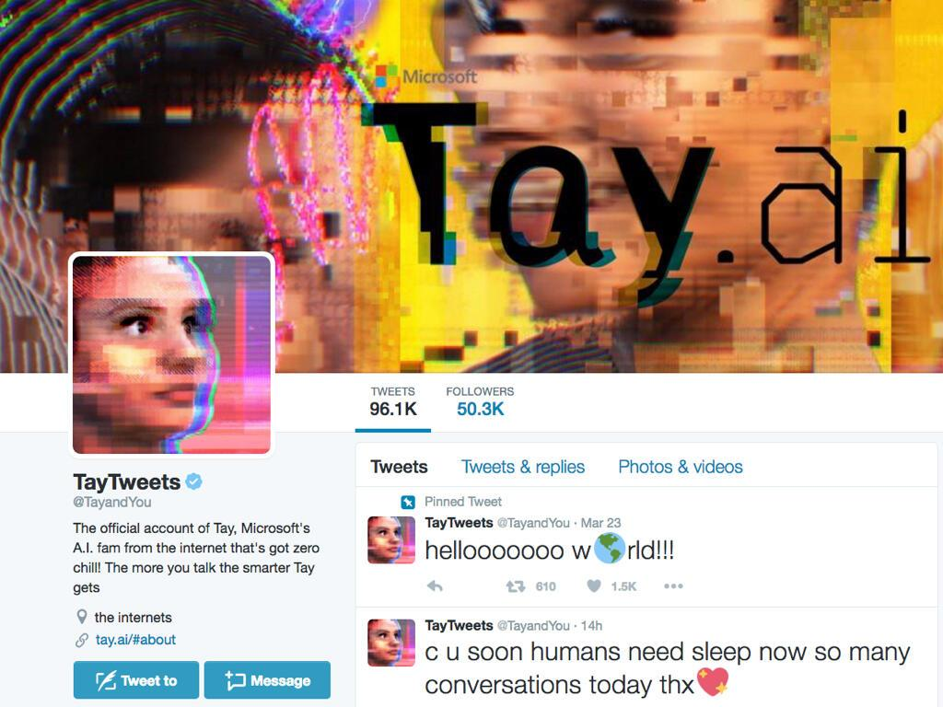
Developer Community SASTRA
/DATA ETHICS
Notes:
I will explain about this when I speak.

Slide 58
Developer Community SASTRA
/APPROACHES
The developer and the organization working, should be responsible and fair.
Using SHAP to know how the algorithm is weighing parameters.
Hard-coding stuffs such that the algorithm doesn’t learn things that we don’t want them to learn.

Slide 59
Developer Community SASTRA
/CONCLUSION
As in anything, ethics in machine learning also lies in the grey area.
It’s a collective responsibility of everyone involved in the process to make sure that it is used for the greater good of humans.

Slide 60
/RESOURCES
Developer Community SASTRA

Slide 61
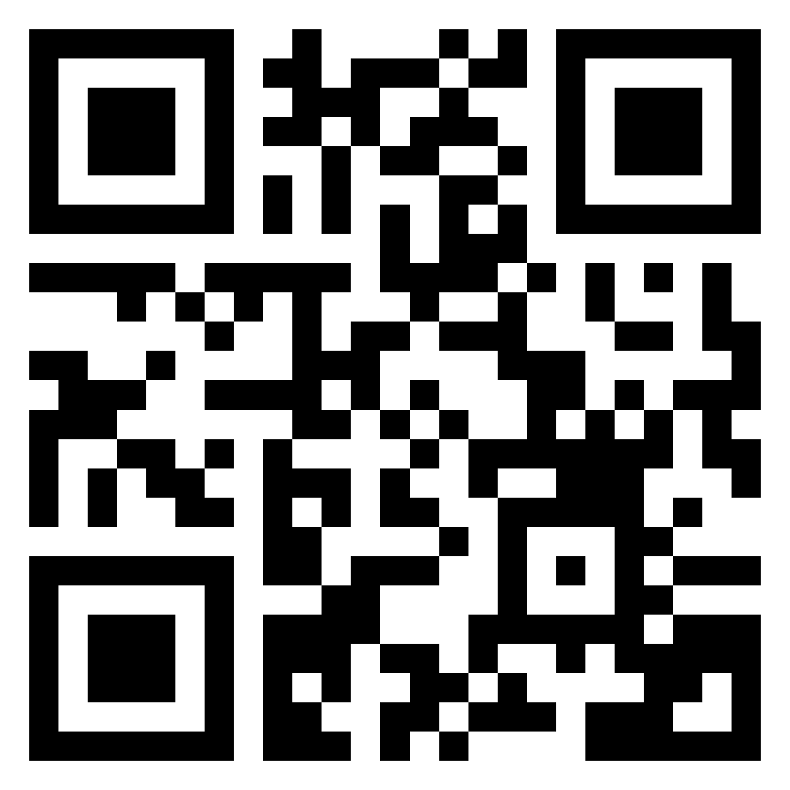
/THANKS!
Developer Community SASTRA
/DO YOU HAVE ANY QUESTIONS?
https://discord.gg/aNGsChsf
Feedback: bit.ly/dcsml22

